Slide 1
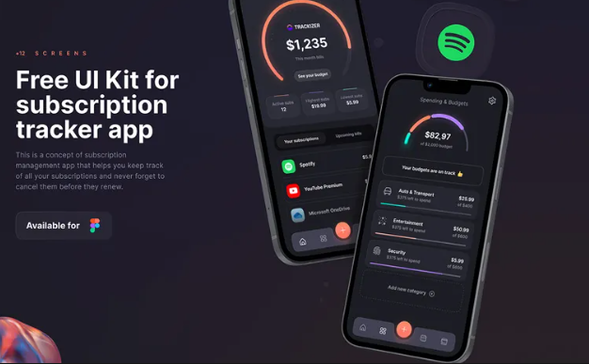
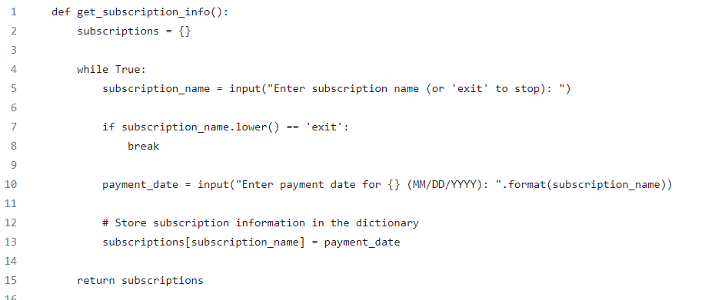
A software which allows user to access all their subscription in one location, while reminding them of upcoming payments. Users would be able to keep track of subscriptions, see different payment plan for subscription as well as the dates for upcoming bills.
VISIT HERE FOR MORE INFO: https://github.com/ksu-is/Subscription-Tracker

